Slide 1
Startup Fundraising
Prof. Dr. Dirk Riehle
Friedrich-Alexander University Erlangen-Nürnberg
COSS D04
Licensed under CC BY 4.0 International
Notes:
It is Friedrich-Alexander University Erlangen-Nürnberg – FAU, in short.
Corporate identity wants us to say “Friedrich-Alexander University”.

Slide 2
Agenda
Startup time-line
Types of funding
The main players
Startup valuation
A funding round
Risk profiles

Slide 3
1. Startup Time-line

Slide 4
The Startup Time-line
founding
problem-solution fit
product-market fit
product-channel fit
exit
university
private and independent
post-exit
12 months
18 months
... months
liquidity event
time
Seed
Series A
Series B
Series n
business angels
venture capitalists
on average 5 to 8 years (and growing)

Slide 5
Early Financial Needs Time-line
Stage | Headcount | Funding | Responsible
Research | Jane and Jim | (2 people at €80K + €30K) x 4 years | Professor
Validation | Jane, Jim, Tony | (3 people at €80K + €50K) x 2 years | Entrepreneurs
Incorporation | 4 | (4 people at €80K + €50K) x 2 years | Entrepreneurs
Going concern | n+ | (n+ people at €80K + €30K) p.a. + ... | Entrepreneurs

Slide 6
2. Types of Funding

Slide 7
Forms of Funding
Type | Source
Gift | Self-exploitation Public and NGO funders
Debt | Family, friends, and fools Loans
Investment | Business angels Venture capitalists
Projects | Public agencies Companies

Slide 8
Public Funders and Programs (Recap)
# | Phase | Funder | Program | # Persons | Amount [PM p. P.]
1 | Basic research | DFG ERC | Sachbeihilfe Advanced Grant | 1-3 (up to 6) | 36
2 | Applied research | BMBF BMWi | VIP+, START interaktiv Various | 1-4 | 18-36
3 | Spinning-off | BMWi | EXIST Forschungstransfer | 3-4 | 18
4 | Starting-up | BMWi | EXIST II | 3-4 | 6
5 | ... | BMWi | KMU Innovativ | ... | 12-24

Slide 9
Business Angels
A business angel
  Is typically an individual investing their own money
  May bring in other business angels
  Is sometimes specialized, but more often general purpose
Value proposition
  Is typically money + personal involvement (expertise, network, etc.)
  Personal involvement may or may not be a good idea

Slide 10
Venture Capital Firms
A venture capital firm
  Is a financial service firm that promises its investors outsize returns from startup investments
  May invest in your startup if you fit their bill
  Is sometimes general purpose, but more often specialized
Value proposition
  Is to bring money and more money through partners
  Sometimes comes with useful services
Venture capitalists = general partners at venture capital firm

Slide 11
Example Funding Strategy and Time-line
...
Recipient
of funding
University
Research project funding
DFG, BMBF, BMWi, EU
Research project funding
DFG, BMBF, BMWi, EU
Source of funding
Public
agencies
Validation funding, e.g. BMBF VIP+, 500K
Incorporation funding, e.g. EXIST Forschungstransfer, BMWi, 500K - 1M
Startup
EXIST FT II,
BMWi, 180K
time
founding
Startup funding, e.g. BMBF START interaktiv, 400K for startup
…
Seed funding, business angels, 50K - 1M
Series A.. funding, venture capitalists, 1M+
Private
funders

Slide 12
3. The Main Players

Slide 13
The Ecosystem and Its Main Players
Investors
  Business angels
  Venture capital firms
Facilitators
  Lawyers
  Professional organizations
Enablers / resources
  Professors
  Universities

Slide 14
4. Startup Valuation

Slide 15
Valuation Methods
Cost of replacement (pre-seed)
Revenue multiples (Series A onwards)
Discounted cash flows (later)

Slide 16
Cost of Replacement Method
Asset | Cost of Replacment
Source code | # person months x labor rate
Machinery | Price according to price list Price according to market place
Skilled labor | Recruiting costs

Slide 17
Revenue Multiples Method
Value of company = Revenue x Multiple
  Revenue is typically annual (maybe extrapolated) revenue
  Multiple is a negotiated factor based on growth rate and industry
Category [1] | Percentage [YoY] | Multiple
Slow growth | <10% | 1x – 2x
Stable growth | 10% - 30% | 2x – 5x
High growth | 30% - 100% | 5x – 10x
Super high growth | 100% - 300% | 10x – 15x
Hyper growth | 300%+ | 15x – 25x
[1] See https://microcap.co/startup-valuation-revenue-multiple

Slide 18
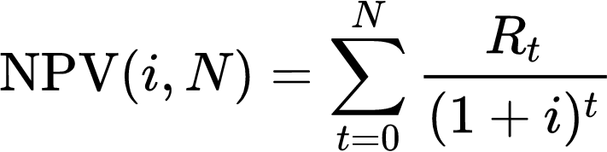
Net Present Value / Discounted Cash Flow Method
The net present value (NPV) of a firm is
  The sum of all future cash-flows
  Brought back in value to today
NPV = sum of (future cash flows at time t / (1 + discount rate) to the power of t)
  The discount factor is the expected rate of return of comparable investments
[1] See https://en.wikipedia.org/wiki/Net_present_value

Slide 19
5. A Funding Round

Slide 20
Company Valuation Pre- and Post-Money
Step | Value
Pre-money valuation | €4M
Investment by investor | €1M
Post-money valuation | €5M
Equity stake to investor | 20%

Slide 21
Example Term Sheet 1 /2 [1]
Company: | [__________], a Delaware corporation.
Securities: | Series A Preferred Stock of the Company (“Series A”).
Investment Amounts: | $[_] million from [__________] (“Lead Investor”) $[_] million from other investors Convertible notes and safes (“Convertibles”) convert on their terms into shadow series of preferred stock (together with the Series A, the “Preferred Stock”).
Valuation: | $[_] million post-money valuation, including an available option pool equal to [__]% of the post-Closing fully-diluted capitalization.
Liquidation Preference: | 1x non-participating preference. A sale of all or substantially all of the Company’s assets, or a merger (collectively, a “Company Sale”), will be treated as a liquidation.
Dividends: | 6% noncumulative, payable if and when declared by the Board of Directors.
Conversion to Common Stock: | At holder’s option and automatically on (i) IPO or (ii) approval of a majority of Preferred Stock (on an as-converted basis) (the “Preferred Majority”). Conversion ratio initially 1-to-1, subject to standard adjustments.
[1] See https://www.ycombinator.com/series_a_term_sheet/

Slide 22
Example Term Sheet 2 / 2
Voting Rights: | Approval of the Preferred Majority required to (i) change rights, preferences or privileges of the Preferred Stock; (ii) change the authorized number of shares; (iii) create securities senior or pari passu to the existing Preferred Stock; (iv) redeem or repurchase any shares (except for purchases at cost upon termination of services or exercises of contractual rights of first refusal); (v) declare or pay any dividend; (vi) change the authorized number of directors; or (vii) liquidate or dissolve, including a Company Sale. Otherwise votes with Common Stock on an as‑converted basis.
Drag-Along: | Founders, investors and 1% stockholders required to vote for a Company Sale approved by (i) the Board, (ii) the Preferred Majority and (iii) a majority of Common Stock [(excluding shares of Common Stock issuable or issued upon conversion of the Preferred Stock)] (the “Common Majority”), subject to standard exceptions.
Other Rights & Matters: | The Preferred Stock will have standard broad-based weighted average anti-dilution rights, first refusal and co-sale rights over founder stock transfers, registration rights, pro rata rights and information rights. Company counsel drafts documents. Company pays Lead Investor’s legal fees, capped at $30,000.
Board: | [Lead Investor designates 1 director. Common Majority designates 2 directors.]
Founder and Employee Vesting: | Founders: [_______________]. Employees: 4-year monthly vesting with 1-year cliff.

Slide 23
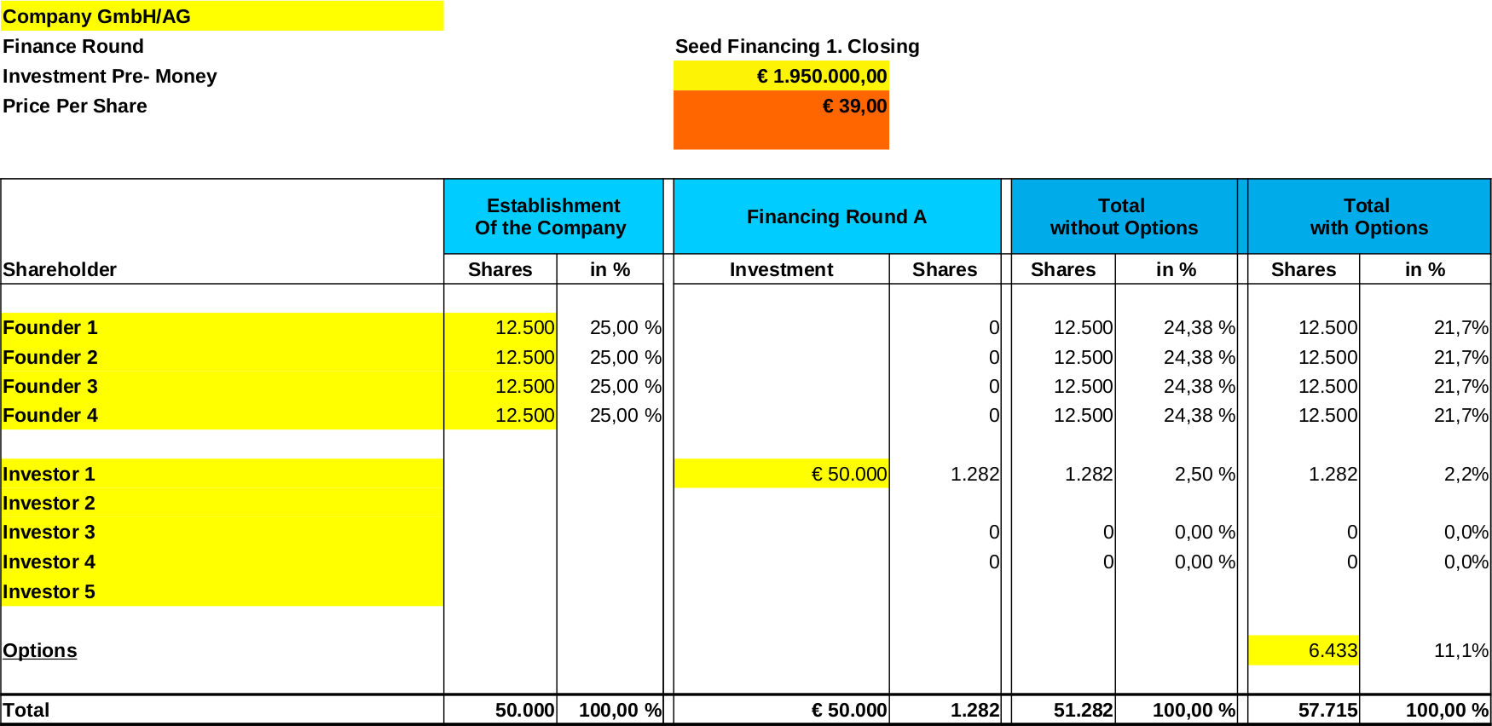
The Cap(italization) Table [1]
[1] See
https://standardsinstitute.de/term-sheet/

Slide 24
6. Risk Profiles

Slide 25
Risk Profiles and Conflicts of Interest
Founders
Investors
  Business angels
  Venture capital
  Private equity

Slide 26
Summary
Startup time-line
Types of funding
The main players
Startup valuation
A funding round
Risk profiles

Slide 27
Thank you! Questions?
dirk.riehle@fau.de – https://oss.cs.fau.de
dirk@riehle.org – https://dirkriehle.com – @dirkriehle
DR

Slide 28
Credits and License
Original version
  © 2021 Dirk Riehle, some rights reserved
  Licensed under Creative Commons Attribution 4.0 International License
Contributions
  None yet

